Slide 1




NEXT GEN EMPLOYABILITY PROGRAM
Creating a future-ready workforce
Team Members
College Name
Student Name : MANOJ T
Student ID : 950821104025
Government College of Engineering, Tirunelveli

Slide 2

CAPSTONE PROJECT SHOWCASE
Project Title
Voting Application using Django Framework
Abstract | Problem Statement | Project Overview | Proposed Solution | Technology Used | Modelling & Results | Conclusion

Slide 3
Abstract
The abstract provides a concise summary of your project, highlighting its objectives, methods, and key findings.
This project aims to develop a digital voting application using the Django framework to address the inefficiencies and security concerns of traditional voting systems.
By leveraging Django's robust features for web development and security, the application provides a user-friendly interface for voters to cast their votes securely and efficiently.
Abstract
Source : Original Content

Slide 4
Problem Statement
Traditional voting systems face challenges such as long queues, logistical issues, and susceptibility to fraud or tampering.
The need for a modern, digital voting solution that ensures the integrity and confidentiality of votes while enhancing accessibility and convenience is paramount.
Source :
Source : Original Content

Slide 5
Project Overview
The voting application project seeks to revolutionize the voting process by providing a secure, user-friendly platform for voters to cast their ballots remotely.
Key features include user authentication, ballot creation, candidate selection, and result tabulation, all within a seamless web-based interface.
Source :
Source : Original Content

Slide 6
Proposed Solution
.
The project proposes a digital voting application built on the Django framework, leveraging its robustness and security features.
The application's architecture includes components for user authentication, ballot management, voting process management, and result generation.
By employing encryption techniques and access controls, the application ensures the confidentiality and integrity of votes, mitigating the risk of tampering or manipulation.
Source :
Source : Original Content

Slide 7


Technology Used
Front-end
Back-end
Source :
Source : www.google.com

Slide 8
Modelling & Results
User Authentication: Implemented secure user authentication using Django's built-in authentication system, ensuring that only authorized users can access the voting platform.
Ballot Creation: Developed functionality for creating and customizing ballots based on election requirements, enabling administrators to define candidate options and ballot structures.
Voting Process Management: Implemented a smooth and intuitive interface for voters to select their preferred candidates and submit their votes securely.
Result Tabulation: Designed algorithms for aggregating and tabulating votes to determine election outcomes accurately and efficiently.
Source :
Source : Original Content

Slide 9
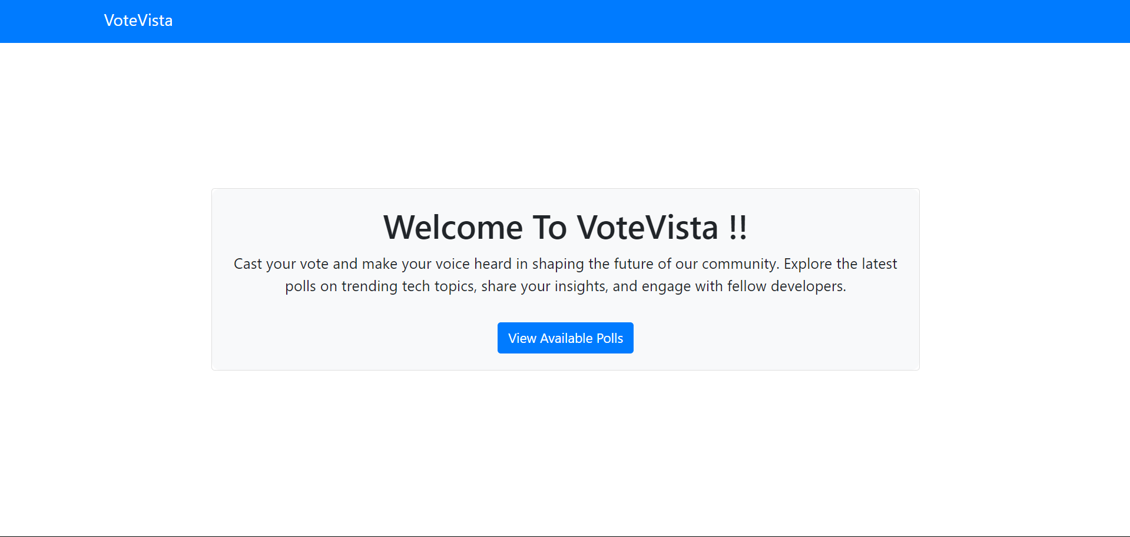
Homepage

Slide 10
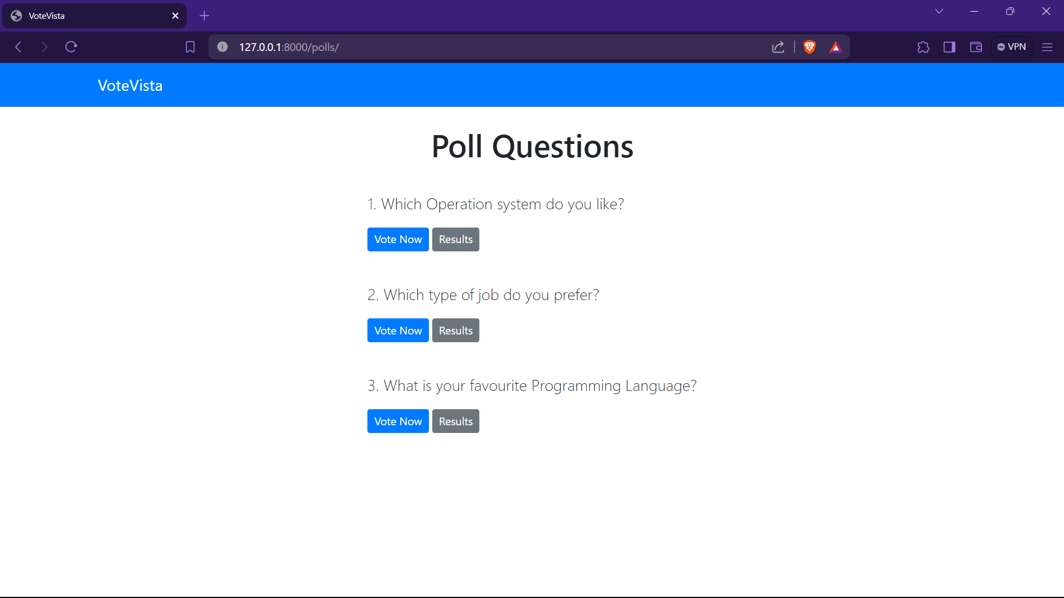
Poll-List-Page

Slide 11
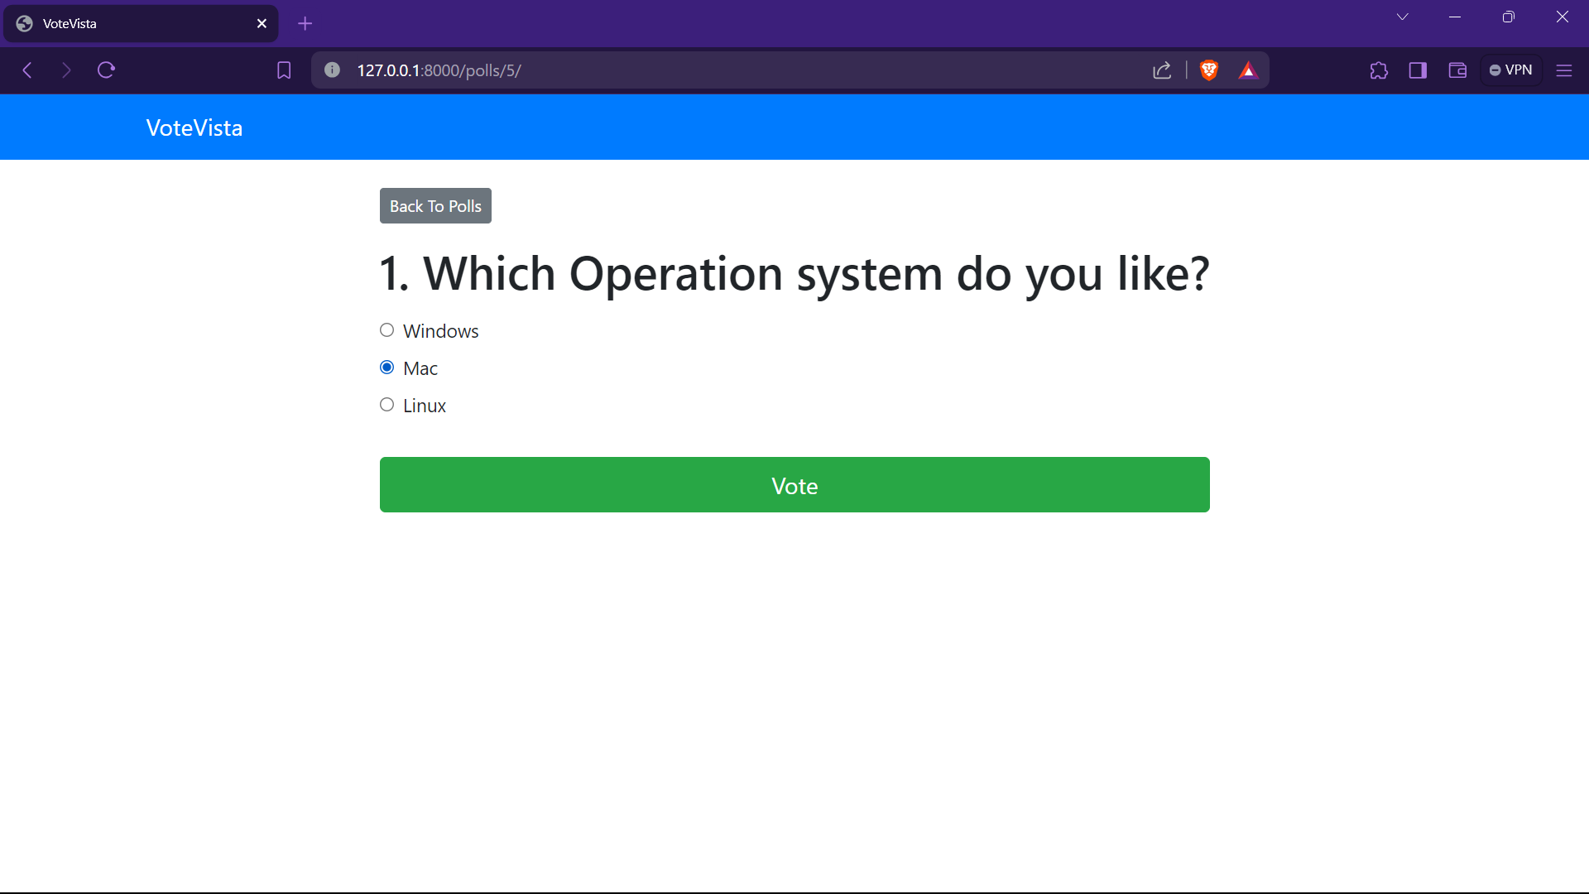
Voting-Page

Slide 12
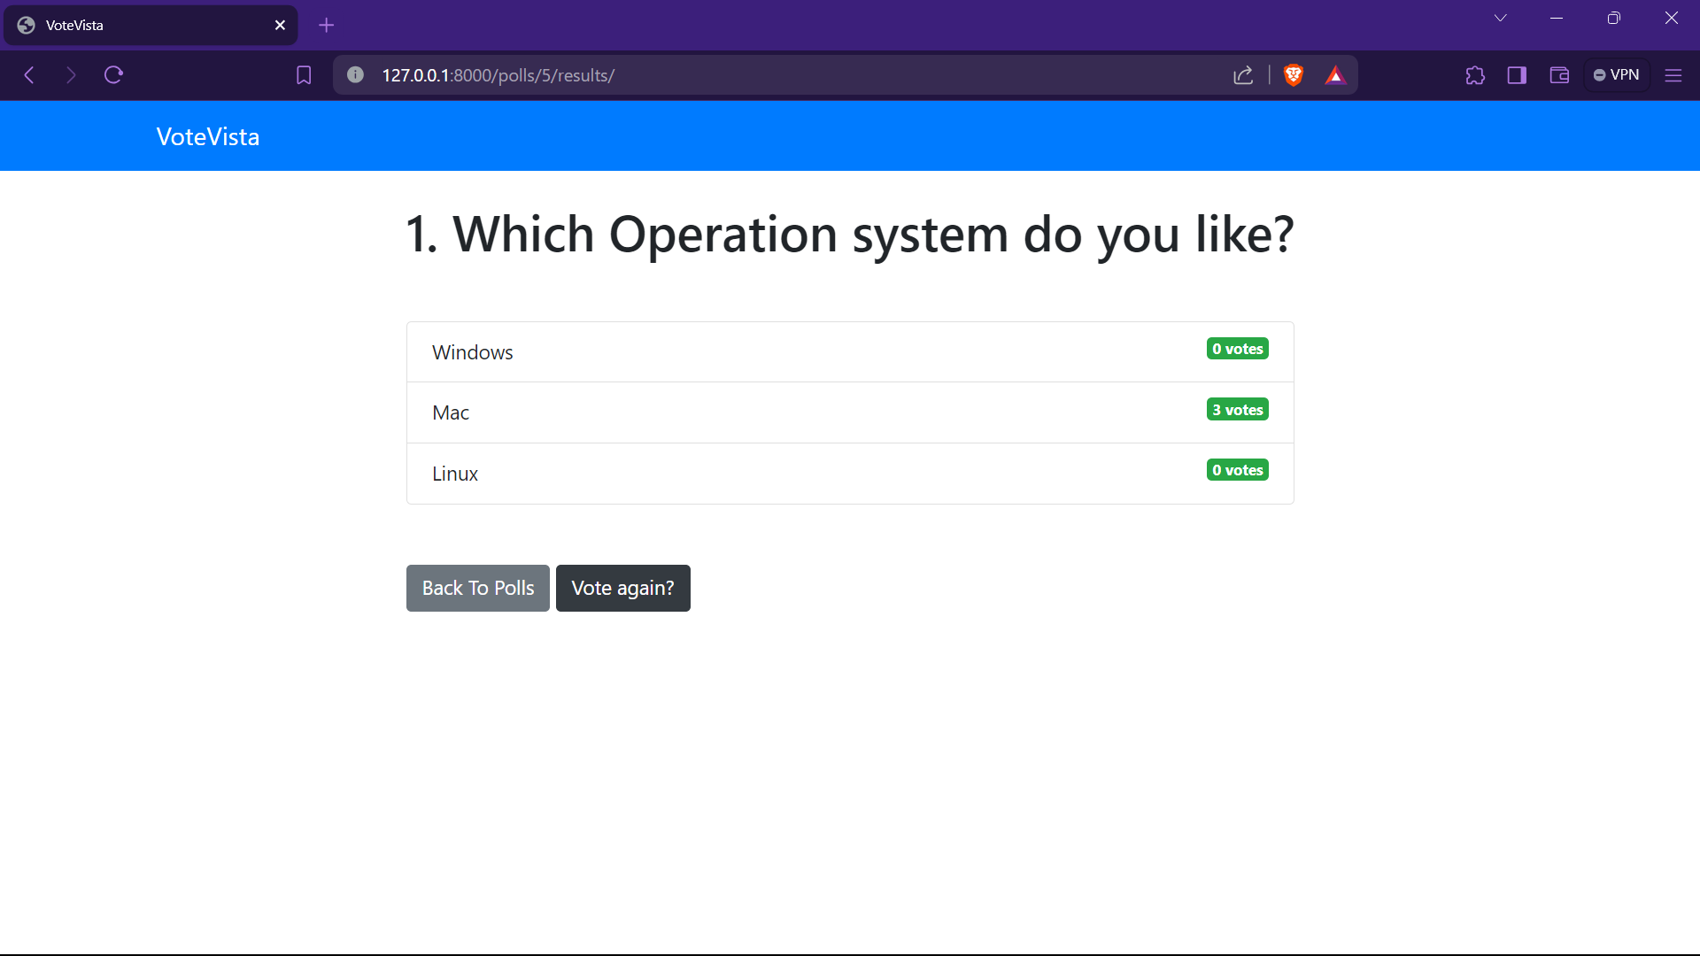
Result-Page

Slide 13
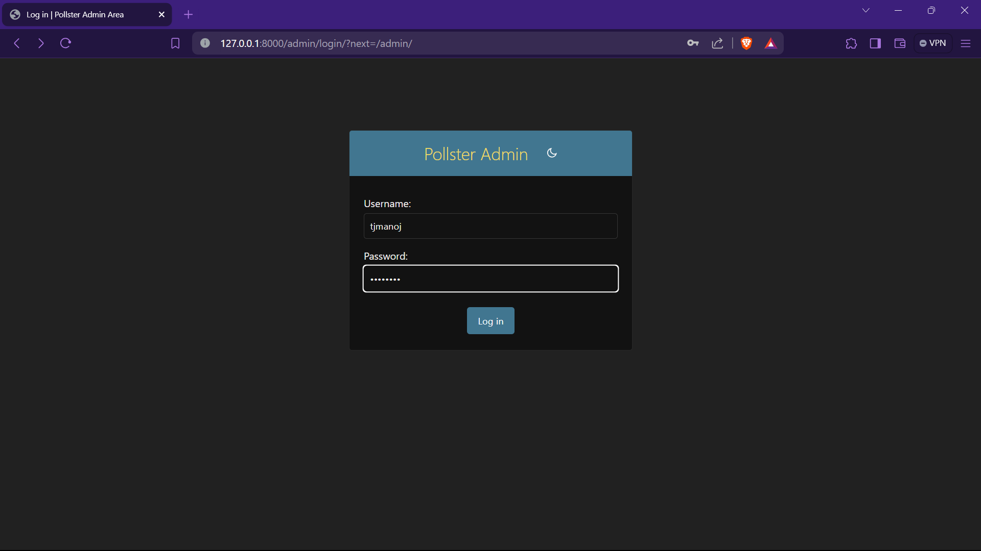
Admin-Login-Page

Slide 14
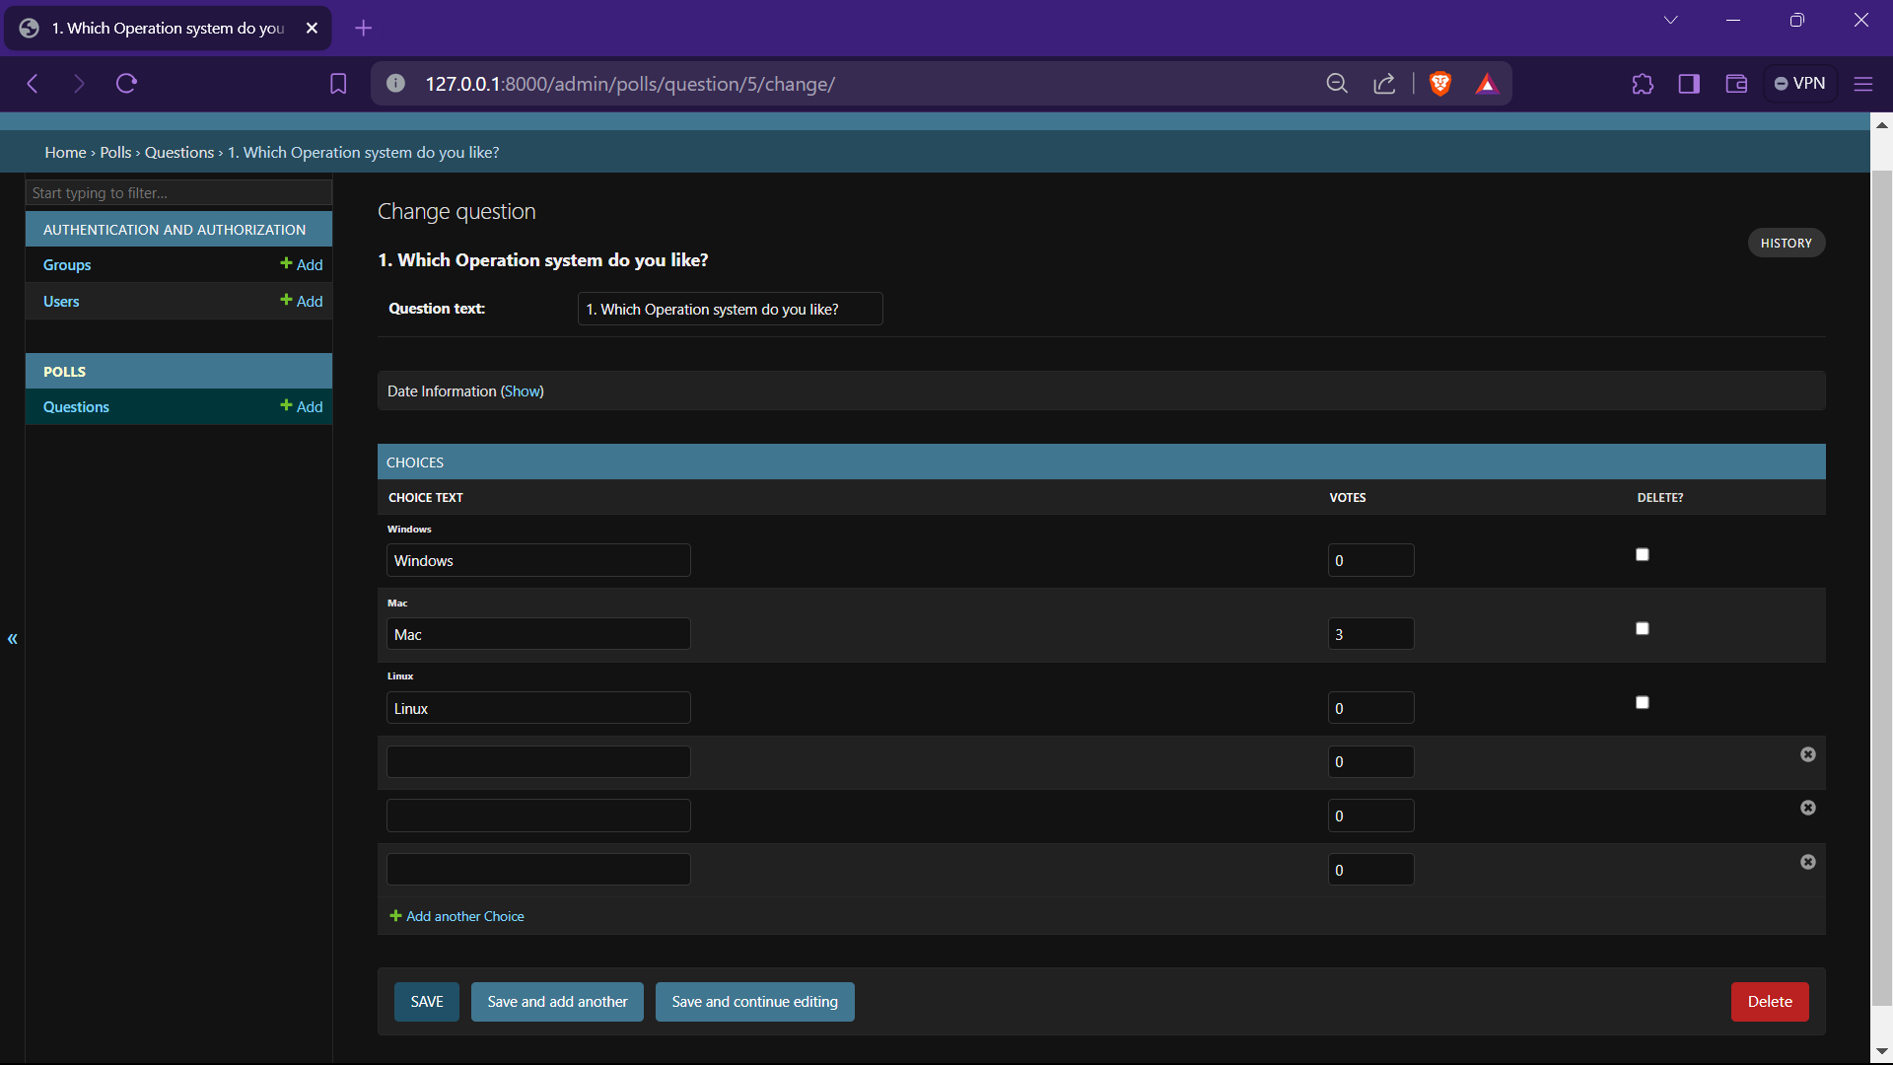
Add-Poll-Page

Slide 15
Future Enhancements:
Blockchain Integration: Explore the integration of blockchain technology to enhance the security and transparency of the voting process. Blockchain can provide immutable and decentralized storage of voting records, reducing the risk of tampering and fraud.
Mobile Application: Develop a mobile application companion to the web platform, allowing voters to conveniently cast their ballots from their smartphones or tablets. This would improve accessibility and cater to users who prefer mobile devices over desktop computers.
Multi-factor Authentication (MFA): Implement additional layers of security by integrating MFA methods such as SMS-based verification, email confirmation, or biometric authentication. This would further enhance the authentication process and safeguard against unauthorized access.

Slide 16
Conclusion
The Voting Application developed on the Django Framework represents a significant advancement in modernizing the electoral process. Leveraging Django's robust features, the application ensures a secure and user-friendly platform for voters. Integrating blockchain technology enhances transparency, while a mobile app companion increases accessibility. Multi-factor authentication further secures the process. With continued innovation, this application has the potential to redefine democracy, fostering trust and participation in elections globally.
Source :
Source : Original Content

Slide 17
Thank You!
Notes:
Thank You !!

